Slide 1
“Developing the Stony Lake Gold Project in Central Newfoundland - Canada’s Newest Orogenic Gold District.”
CORPORATE PRESENTATION – March 2021
TSX-V: KNC

Slide 2
FORWARD LOOKING STATEMENTS
This Presentation includes, and is based on, forward-looking information and statements including “Forward-Looking Statements” within the meaning of the United States Private Securities Litigation Reform Act. These Forward-Looking Statements include references to or assumptions regarding future prices or demand for vanadium, accuracy of mineral or resource exploration activity, the existence of reserves or resources, regulatory or government requirements or approvals, access to third party information and continued access to mineral properties or infrastructure. The words “anticipate”, “believe”, “estimate”, “expect”, “target”, “plan”, “fast”, “forecast”, “may”, “schedule”, “strategy” and similar words or expressions identify forward-looking information and statements. Forward looking statements are subject to risks and uncertainties that could cause actual results and outcomes to differ.
These risks and uncertainties include, but are not limited to, economic conditions globally, the impact of competition, political and economic developments in the countries in which the Company operates, fluctuations in the margins for the Company’s product, economic and market conditions in the geographic areas and industries that are or could be major markets for the Company’s business, vanadium and uranium prices and market fluctuations, changes in governmental regulations, interest rates, accuracy of mineral or resource exploration activity, the possibility regulatory or government requirements or approvals will not be obtained, access to third party information, access to mineral properties or infrastructure, currency risks including the exchange rate of the USD$ for the CDN$, changes in exploration costs and government royalties or taxes in Canada or USA, disputes with indigenous peoples or other stakeholders and such other factors as may be discussed from time to time. Although the Company believes that its expectations and the information in this Presentation are based upon reasonable assumptions at the time when they are made, it can give no assurance that those expectations will be achieved or that the actual outcomes or results will be as set out in this Presentation.
The Company is not making any representation or warranty, expressed or implied, as to the accuracy, reliability or completeness of the information in the Presentation, and neither the Company nor any of its directors, officers or employees will have any liability to the reader or any other persons resulting from the reader's use of the information in the Presentation. The Company undertakes no obligation to publicly update or revise any forward-looking information or statements in the Presentation. The reader should consult any further disclosure the Company may make in documents it files with applicable securities regulators.
This Presentation is intended for educational and informational purposes only and does not replace independent professional judgment. Statements of fact and opinions expressed are those of the participants individually. The information is not designed to provide financial, tax planning, accounting, investment, business or legal advice in any way whatsoever. The reader should consult with a lawyer, accountant and other professionals in respect of the contents hereof. Furthermore, the information in no way should be construed or interpreted as, or as a part of, an offering of, or a solicitation for the purchase of, securities. Investors are advised to discuss any trading with a registered securities broker or personal finance professional prior to investing.
The technical information contained in this presentation has been reviewed and approved by Chris Healey P.Geo, , a Qualified Person as that term is defined in National Instrument 43-101.
TSX-V: GLV

Slide 3
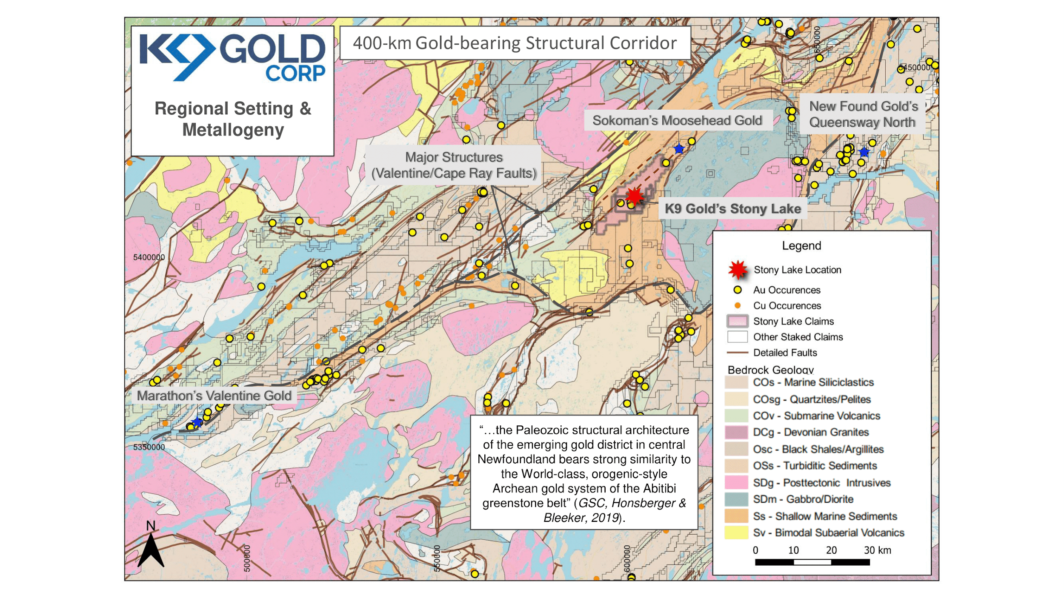
METALLOGENIC SETTING
The Stony Lake Property is located within the Cape Ray/Valentine Lake structural trend in Central Newfoundland along the prolific Dog Bay Line.

Slide 4
STONY LAKE
Deposit Models:
Widespread low grade (0.5 to 4.0 g/t Au) mineralized pyritic sandstone, quartz veins and quartz stockwork as seen exposed in the Silurian-age Botwood Group sediments
A high-grade gold environment (similar to Sokoman’s Moosehead and New Found Gold’s Queensway projects) in the basement rocks below the Botwood sediments
Geology:
Located on the interpreted Cape Ray – Valentine Lake (“CRVL”) structural trend
CRVL covered by oxidized, Silurian, sedimentary rocks
Significant post-sediment felsic intrusives
Mineralization is associated with sericite, silica, ankerite, carbonate, and chlorite as pervasive wallrock alteration, and vein haloes

Slide 5
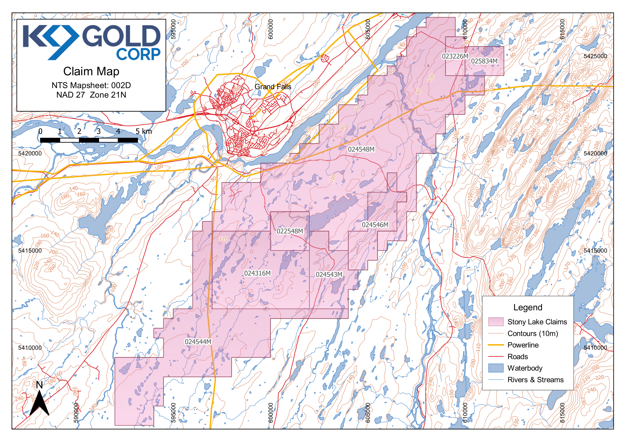
THE STONY LAKE GOLD PROJECT
The Stony Lake Property covers 13,625 ha and 27 kilometers of favorable trend between Sokoman’s Moosehead discovery to the northeast and Marathon's Valentine Lake deposit to the southwest. The structure trends parallel to New Found Gold’s Queensway Project.
2021 EXPLORATION
DCIP Survey
Till Sampling
Geological Mapping
Trenching
Drilling

Slide 6
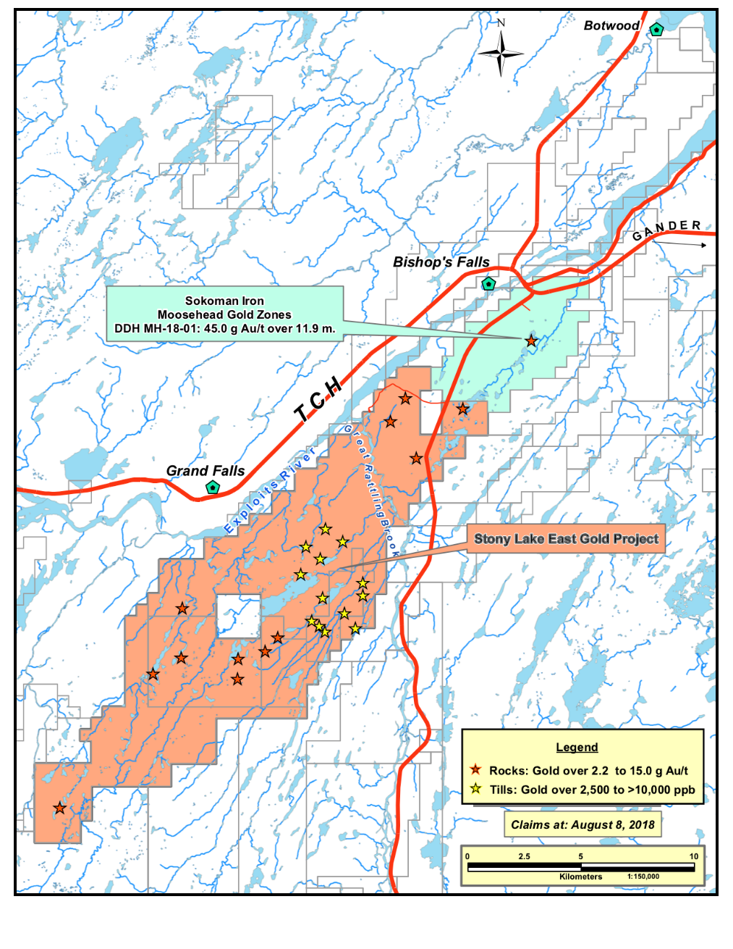
EXPLORATION DETAILS
Exploration 2019:
• A preliminary field program focused on prospecting, mapping, and sampling.
• A property-wide airborne magnetometer and radiometric survey mapped bedrock lithologies, structural features, and structurally-controlled alteration.
As a result, seven areas containing highly anomalous gold values have been identified.
• Mineralization is hosted in quartz feldspar porphyry, pyrite- and arsenopyrite-bearing reduced sandstone, quartz stockwork, and quartz veins. • Arsenic-antimony-molybdenum geochemical associations with high gold to silver ratios are exhibited in mineralization zones. • Sericite, silica, carbonate (including ankerite), and chlorite alteration are observed in mineralized zones, typically as pervasive haloes around quartz stockwork and quartz veins.
• Pyrite and arsenopyrite (1-3% total sulfide) are commonly associated with gold mineralization, specifically in all samples greater than 50 ppb gold.
Sokoman Minerals
Moosehead Project
Stony Lake
17 samples grading from 1.0 g/t to 4.1 g/t.
g/t = grams per tonne; ppb = parts per billion

Slide 7
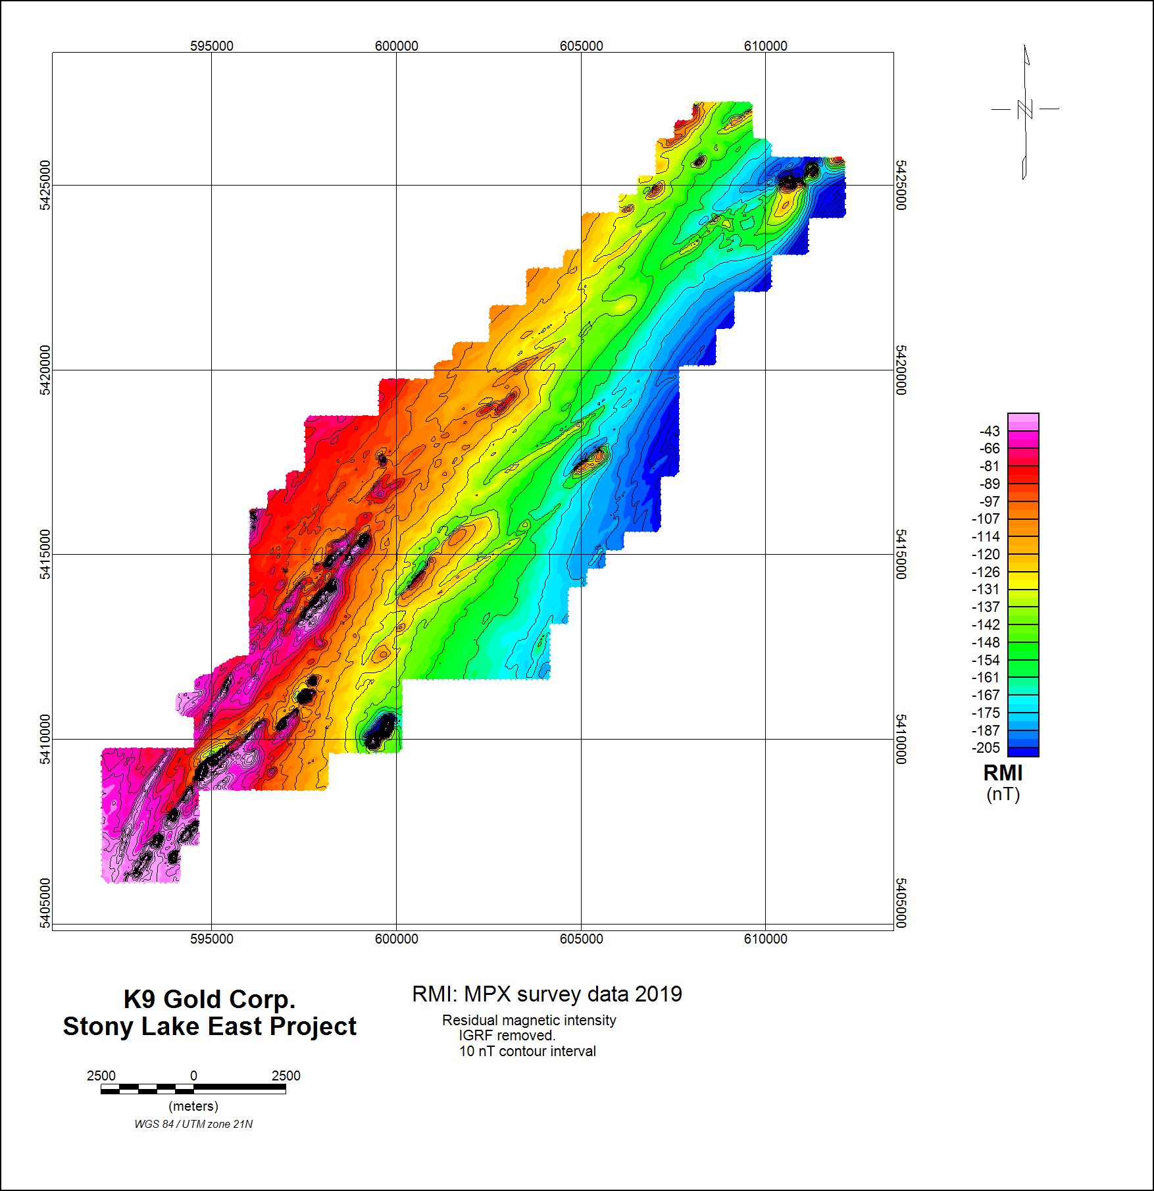
GEOPHYSICAL SURVEYS
• The 2019 airborne magnetic and 2020 VTEM surveys and subsequent interpretation clearly show that the structural trend of Sokoman's Moosehead discovery crosses onto the Stony Lake property. This appears to be a primary basement structure, with multiple splays off it. Further 3D inversions have defined numerous high priority exploration targets.
• In addition, the interpretations indicate that
concentration of zones of gold mineralization
discovered in the Botwood sediments in 2019 is along a NNE structural trend in the Botwood. Although this is a different, parallel, trend to that discussed above, the model is the same: a major structure with gold-bearing fluids emanating from a basement structure depositing low grade mineralization in the Botwood Sediments.

Slide 8
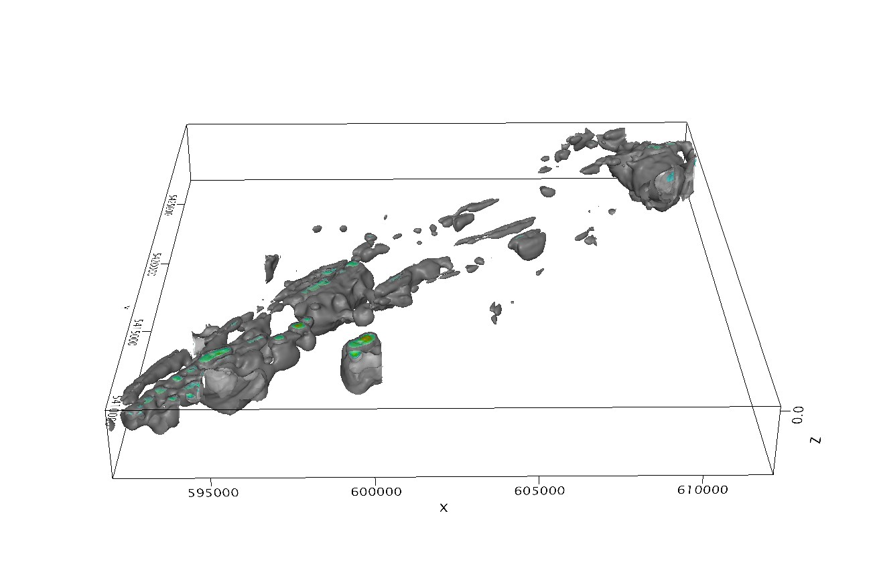
2021 3D INVERSION
• A 3D inversion of the airborne magnetic data has helped to define subsurface structures and has highlighted numerous anomalies for ground DCIP surveys.
• The NNE-trending anomaly intensifies toward the south of the property, which may represent potential shear structures.
• The NE corner of the property contains an anomalous magnetic high, which corresponds to known mineralization at Jumper’s Pond, which was drilled in 2001 by Cornerstone Resources.
50m Depth Slice

Slide 9
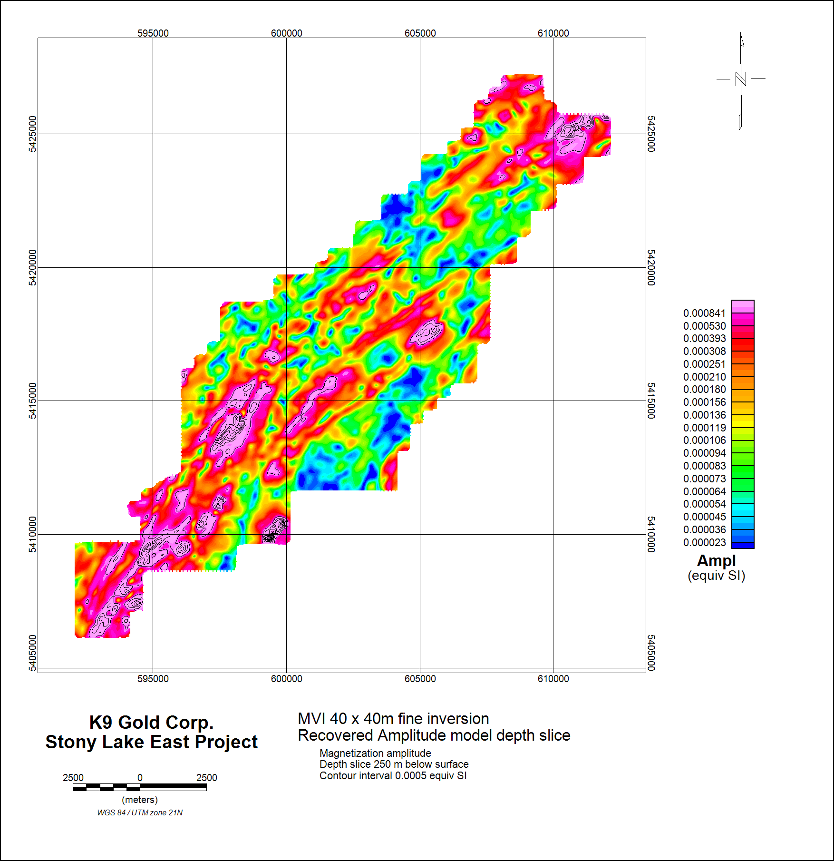
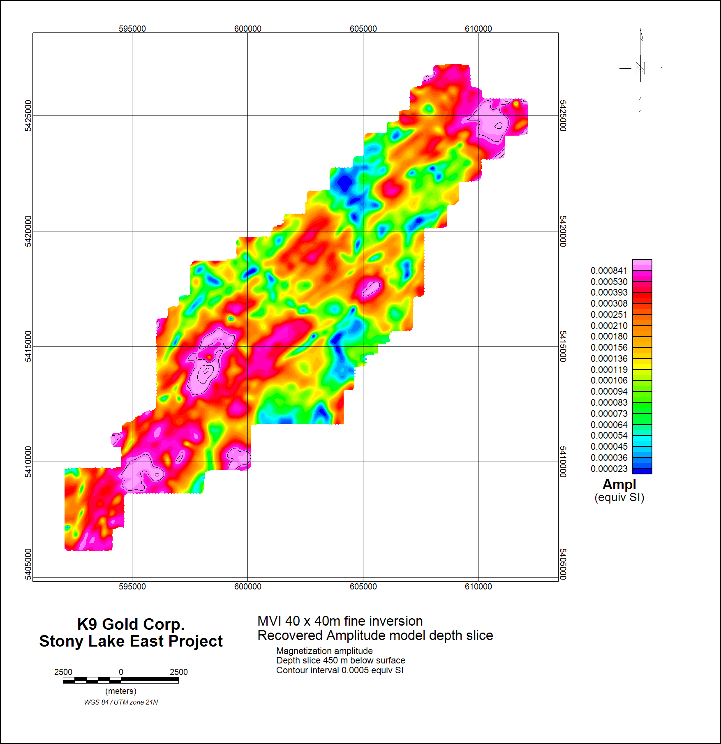
2021 3D INVERSION
250m Depth Slice
450m Depth Slice

Slide 10
2020 VTEM SECTIONS: JUMPER’S POND
RDI Line 2370
RDI Line 2360
200
0
−200
−400
−600
RDI Line
2350
RDI Line 2340
Cross-sections, showing interpreted contact of the Botwood and basement, by highlighting the possible lithology change in conductivity from white (low conductivity) to pink (high conductivity).

Slide 11
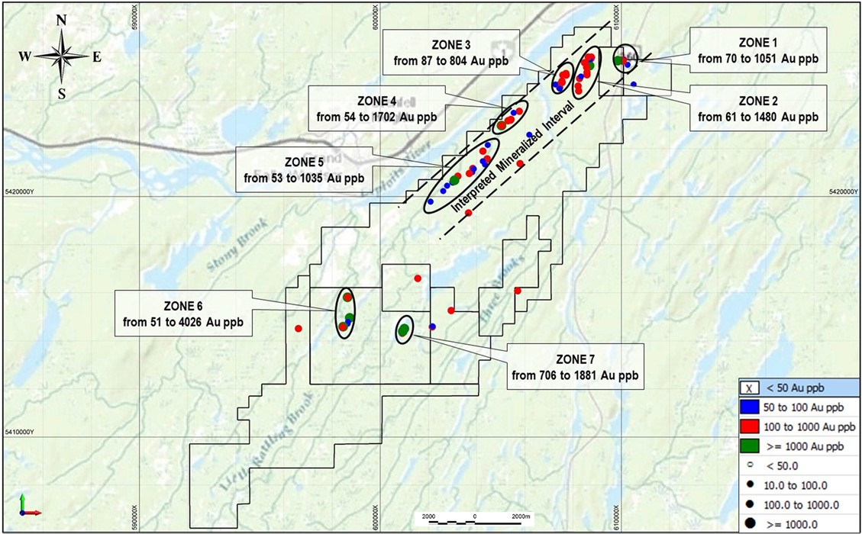
2019 MINERALIZED ZONES

Slide 12
REGIONAL DISCOVERIES
The Stony Lake Project is contiguous to and covers the southwest extension of Sokoman Mineral’s Moosehead high-grade gold discovery. It also lies North East of Marathon’s Valentine Lake Deposit and West of New Found Gold’s Queensway discovery.
Regional Significance
indicates gold potential in this portion of Newfoundland
classified as orogenic style gold setting
intersections of high-grade gold mineralization
Selected Drilling Results
Sokoman; MH-18-01 returned 11.9 m of 44.96 g/t Au (news release July 24, 2017),
MH-20-86 returned 4.70 m of 18.60 g/t Au (news release July 15, 2020)
MH-18-08 returned 1.05 m of 207.1 g/t Au from 8.50 m to 9.55 m and 2.28 m of 42.36 g/t Au
from 33.07 to 35.35 m (Sokoman news release Aug. 28, 2018)
New Found Gold NFGC-19-01 returned 92.9 g/t Au over 19 m incl. 285.29 g/t Au over 6 m (corp. presentation 2020)
Marathon Gold; VL-20-823 returned 3.33 g/t Au over 120.0 m incl. 11.83 g/t Au over 10 m (news release July 2020)
* The gold mineralization on the above-mentioned properties may not be indicative of the gold mineralization on the Stony Lake property
Notes:
Will add additional discoveries

Slide 13
Comparable Companies
 | K9 Gold Corp. | Exploits Discovery Corp. | Sokoman Minerals Corp. | Labrador Gold Corp. | Marathon Gold Corporation | New Found Gold Corp.
Project | Stoney Lake | Jonathan Pond,True Grit,Dog Bay,Mt Peyton,Middle Ridge | Moosehead | Kingsway | Valentine | Queensway
Ownership | 100% | 100% | 100% | 100% | 100% | 100%
Size of Project | 13025 HA | 2111 km 2 | 2450 HA | 7700 HA | 24000 HA | 1500 km 2
Project Stage | Exploration | Exploration | Exploration | Exploration | Production | Exploration
Shares Outstanding | 44,798,189 | 75,392,244 | 165,706,505 | 110,523,104 | 213,421,086 | 151,948,353
Share Price | $0.29 | $0.45 | $0.36 | $0.59 | $2.40 | $4.71
Cash | $4,250,000 | $1,300,000 | $11,000,000 | $11,000,000 | $50,000,000 | $80,000,000
Market Cap (CDN) | $12,991,475 | $33,926,510 | $59,654,342 | $65,208,631 | $512,210,606 | $715,676,743
Notes:
Will add additional discoveries

Slide 14
MANAGEMENT & SHARE STRUCTURE
MANAGEMENT
Jeff Poloni | CEO, President, Director
Brian Morrison | Chief Financial Officer, Director
Kosta Tsoutsis | Director
Chris Healey | Director
Dr. Andreas Rompel | Technical Advisor
Elmer Stewart | Technical Advisor
SHARE STRUCTURE : As of March 1, 2021
Total number of Shares Outstanding: | 44,798,189
Warrants Outstanding: @$0.50 Warrants Outstanding: @$0.42 Warrants Outstanding: @$0.40 | 10,000,000 3,295,500 12,695,810
Options Outstanding: | 1,300,000 @ $0.165 1,500,000 @ $0.55 1,600,000 @ $0.32
Fully Diluted: | 75,189,499

Slide 15
CONTACT INFORMATION:
1455 Bellevue, Suite 300
West Vancouver, BC, V7T 1C3
Jeff Poloni, CEO & Director
jeff.poloni@gmail.com
+1 604 454 8874
Brian Morrison, CFO & Director
brian@millenniallithium.com
+1 604 312 6910

